Slide 1
Unit 3: motion Velocity
Mr. Le
Spring 2018

Slide 2
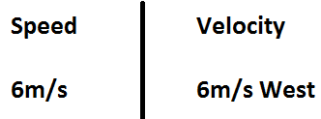
Velocity
Velocity: the speed of an object and the direction it travels.
Velocity is the same as speed, except velocity has direction.
Speed is scalar, while velocity is vector.

Slide 3
Velocity
You solve for velocity the same way as you do for speed, but make sure to include a direction in your final answer.
Velocity shares the same standard unit as speed.
m/s and direction
meters per second + direction

Slide 4
Velocity
If you are moving with constant velocity, are you moving with constant speed? Explain.
If you are moving with constant speed, are you moving with constant velocity? Explain.

Slide 5
Unit 3: motion Acceleration
Mr. Le
Spring 2018

Slide 6
Acceleration
Acceleration: the change in velocity over a period of time.
If velocity is constant, acceleration CAN NOT occur.
Acceleration occurs when an object:
Goes faster (velocity increases)
Slows down (velocity decreases)
Change direction (velocity changes direction)

Slide 7
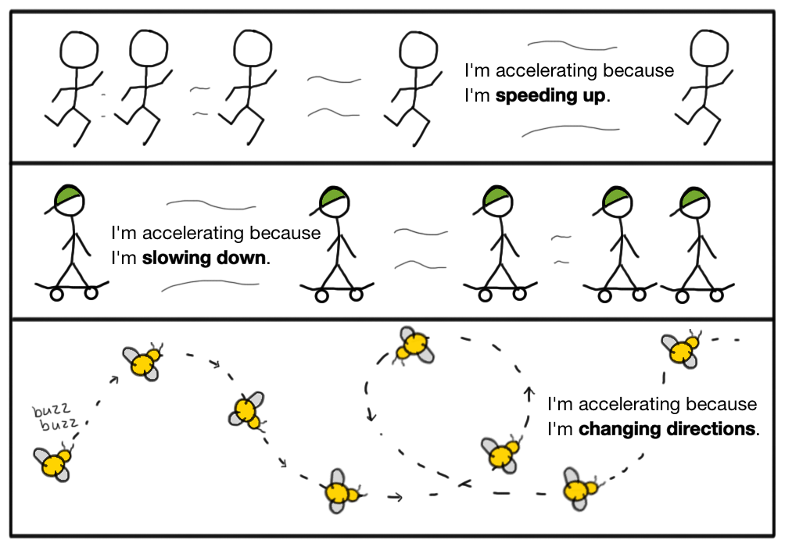

Slide 8
Solving for Acceleration
Don’t have to copy
Initial velocity: the velocity the object started with or its original velocity.
Final velocity: the velocity the object change to or end with
It is important that you do not confuse these two or else you will have an incorrect solution.

Slide 9
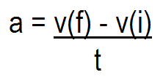
Solving for Acceleration
Don’t have to copy
To find acceleration you take the final velocity and subtract the initial velocity from it. Then, divided the difference by the time.
The unit for acceleration is
meters per second squared or m/s² + direction.
Example: 25 m/s² South

Slide 10
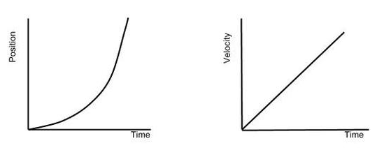
Positive Acceleration
Positive acceleration: when the object’s velocity increases or moves faster.
Positive acceleration is indicated by a positive slope.

Slide 11
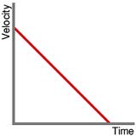
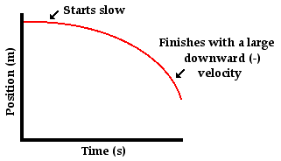
Negative Acceleration
Negative acceleration: when the object’s velocity decreases or moves slower.
Negative acceleration is indicated by a negative slope.

Slide 12
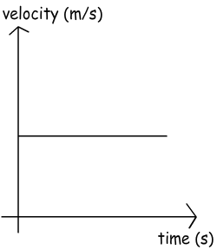
Zero Acceleration
Zero acceleration: when an object has constant velocity.
Zero or no acceleration is indicated by a horizontal line on a velocity vs time graph.

